Slide 1


Department of Information Technology
BVRIT HYDERABAD College of Engineering for Women
LIQUID LEVEL MONITORING AND OVERFLOW PREVENTION SYSTEM USING IoT FOR VISUALLY IMPAIRED
Team- 15
V. Bhargavi(19WH1A1271)
P. Revathi(19WH1A1274)
V. Madhuri(20WH5A1209)
P. Meghana(20WH5A1212)
Under the Guidance of
Ms. Ch. Sai Lalitha Bala
Assistant Professor

Slide 2

Contents
Summary of Stage-1
Implementation
Execution video
Result
Conclusion and Future Scope

Slide 3
Summary of Stage-1
The main aim of the project is to assist the visually impaired individuals by monitoring and detecting the level and temperature of the liquid in a container with a voice assistance.
So in stage 1 we are done with detecting temperature and displaying it on the LCD screen provided.
It gives the assistance through speaker whether the liquid is hot and warm.

Slide 4
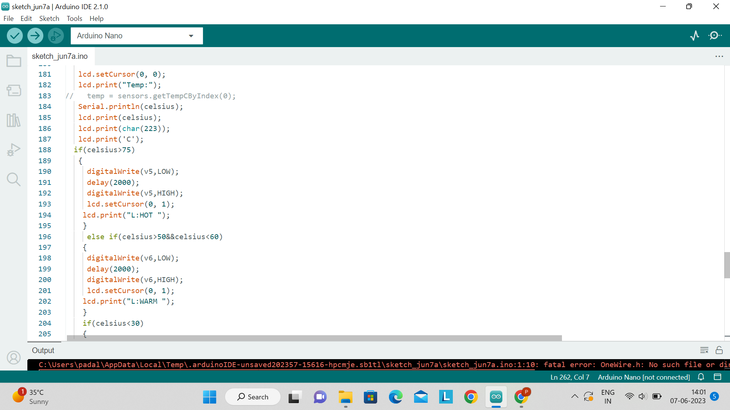
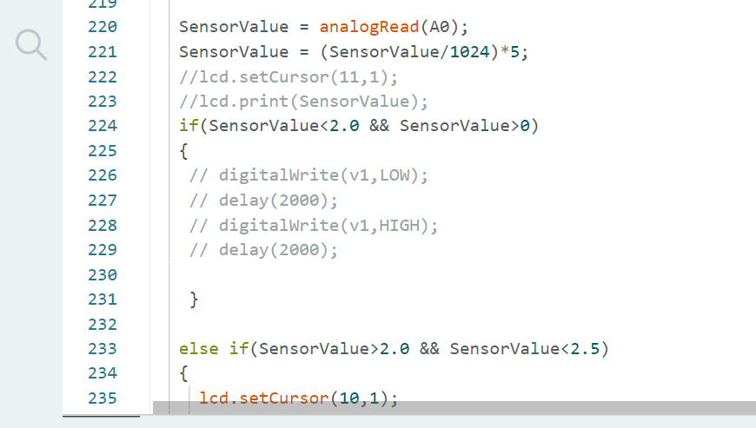
Implementation
Temperature logic:
Liquid level logic:

Slide 5
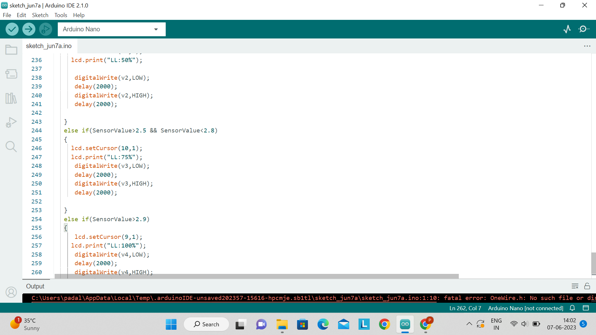
Implementation
Liquid level logic:

Slide 6
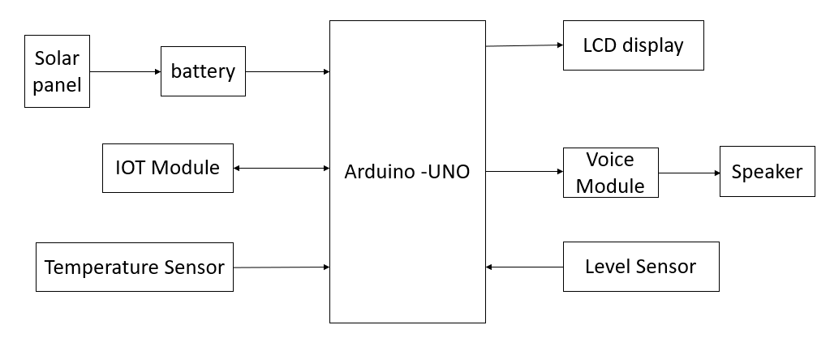
Implementation
System Architecture

Slide 7
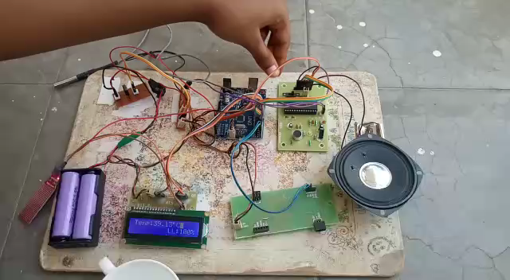
Execution video

Slide 8
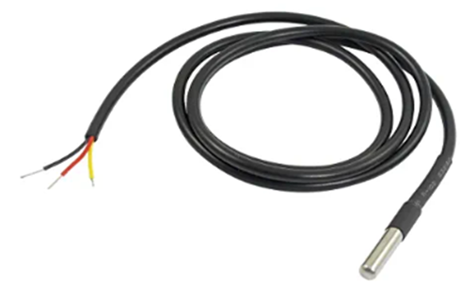
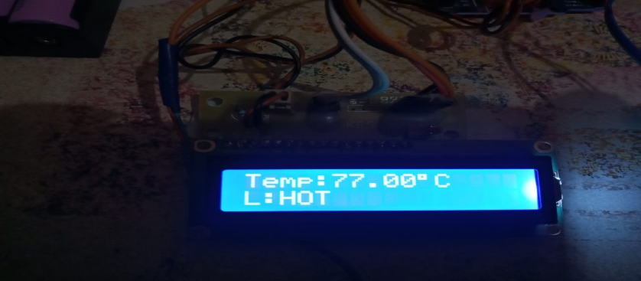
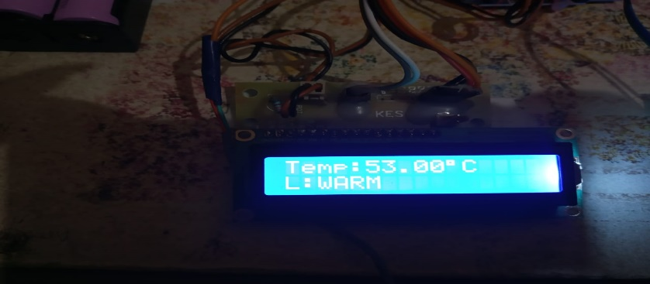
Result
Sensing module
Temperature sensor
Result showing temperature as

Slide 9
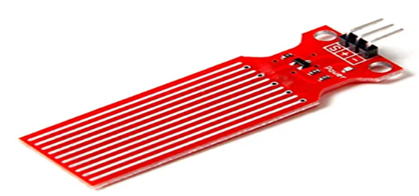
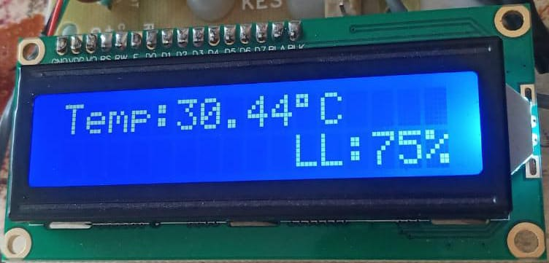
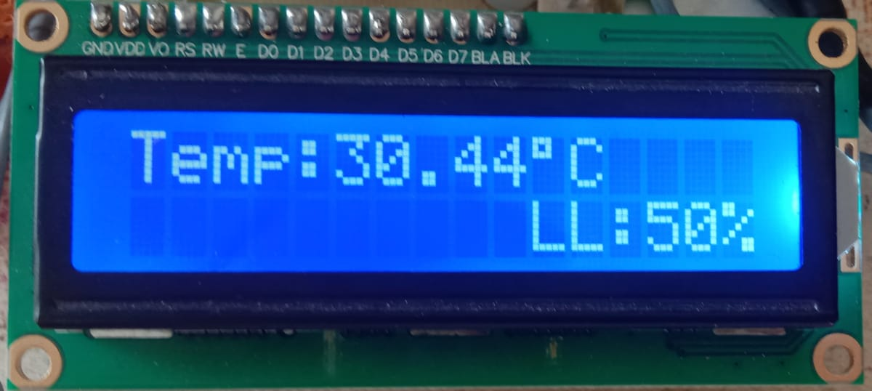
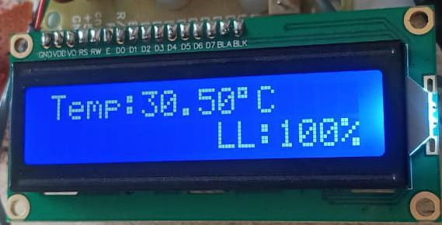
Result
2. Level sensor
Result showing Liquid level as

Slide 10
Conclusion & Future Scope
Our project is based on the detection of temperature and the level of liquid in order to assist the visually impaired through voice. And we completed the solar to recharge the battery.
To make the device more portable and user-friendly, an IC has to be designed. This Compact IC design ensures that the system is handy and easy to carry around.

Slide 11


